Slide 1
LucusEdge Studio
강규리 5/22~20, 26

Slide 2
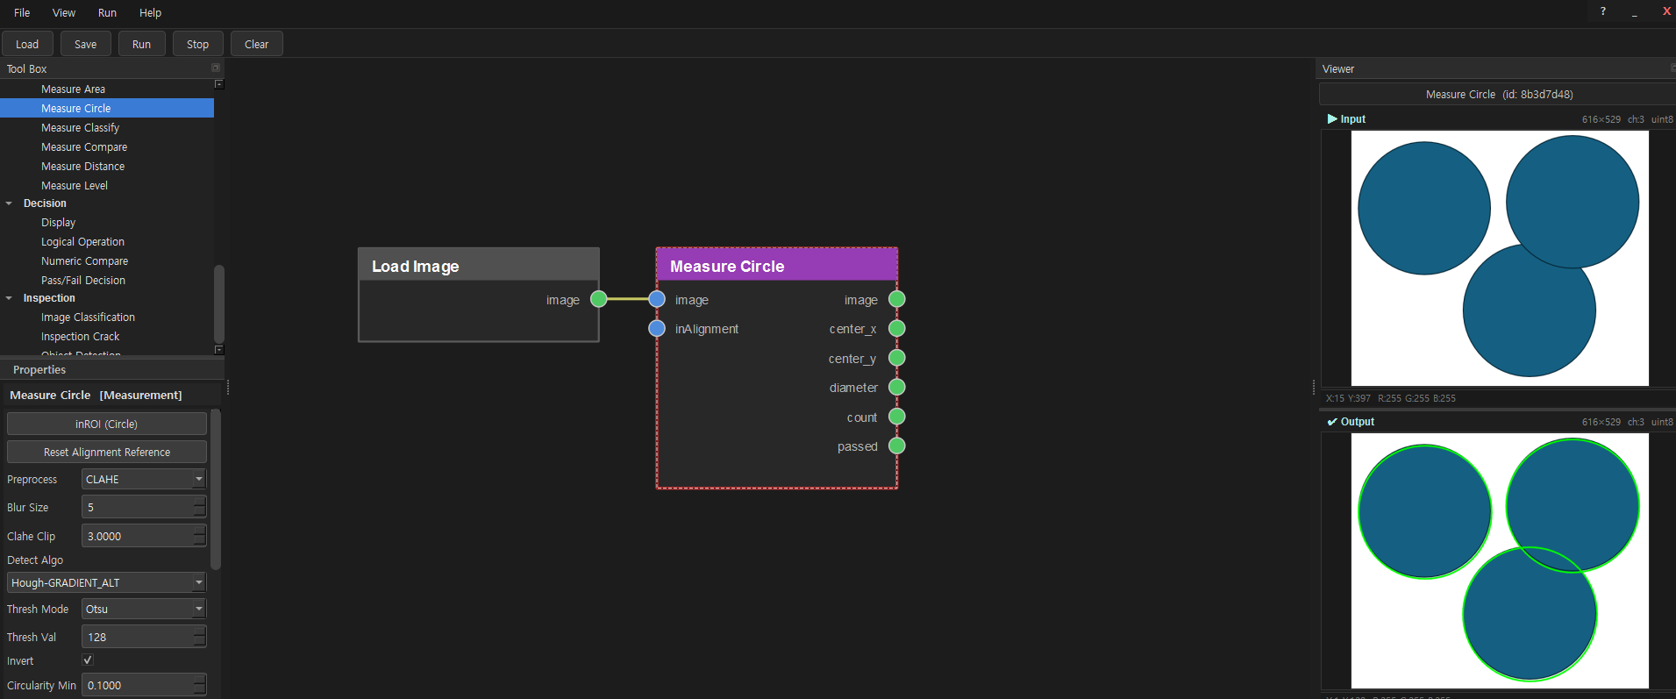
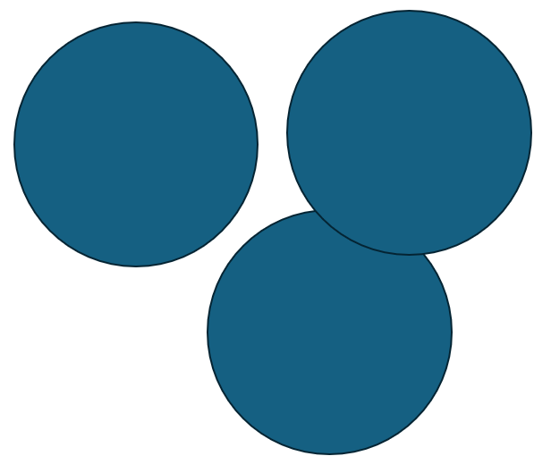
Measure Circle
노드 구조
Input image
- Measure Circle
Detect Algo Hough-GRADIENT_ALT / Invert 🗸

Slide 3
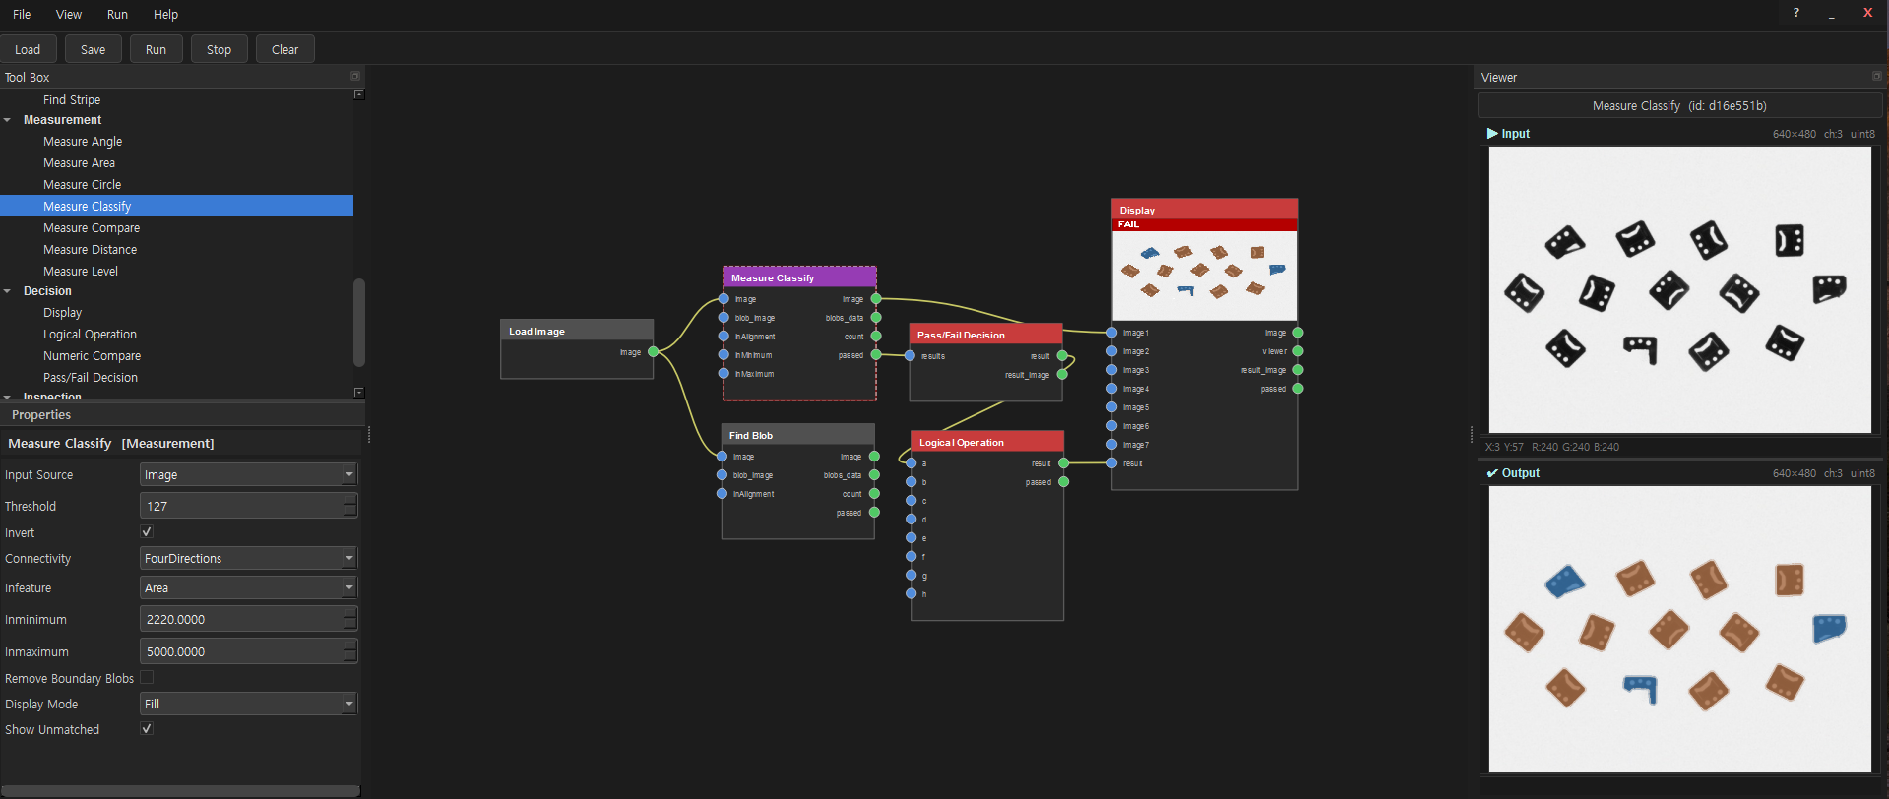
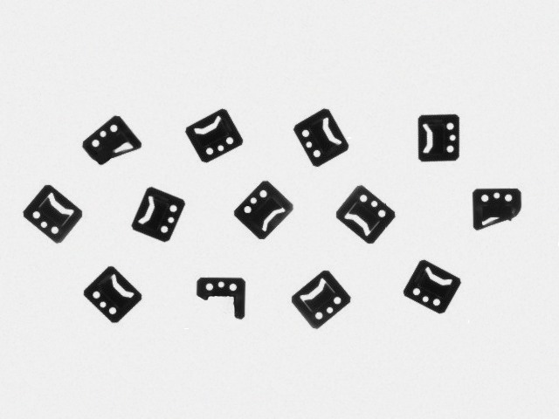
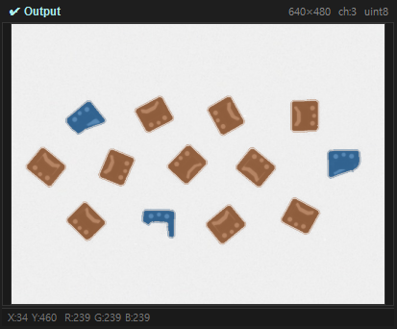
Measure Classify
노드 구조
Input image
- Measure Classify
Input Source Image / Invert 🗸 / Inminimum 2220.0000 / Inmaximum 5000.0000 / Display Mode Fill

Slide 5
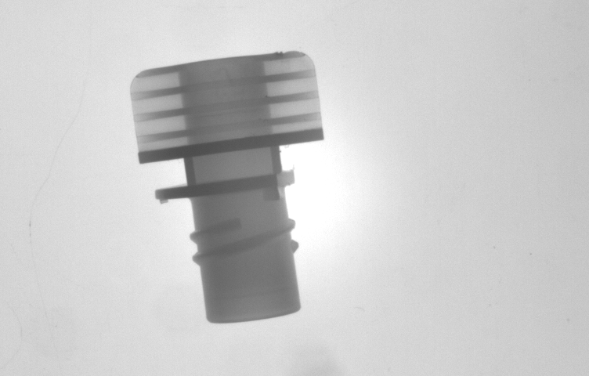
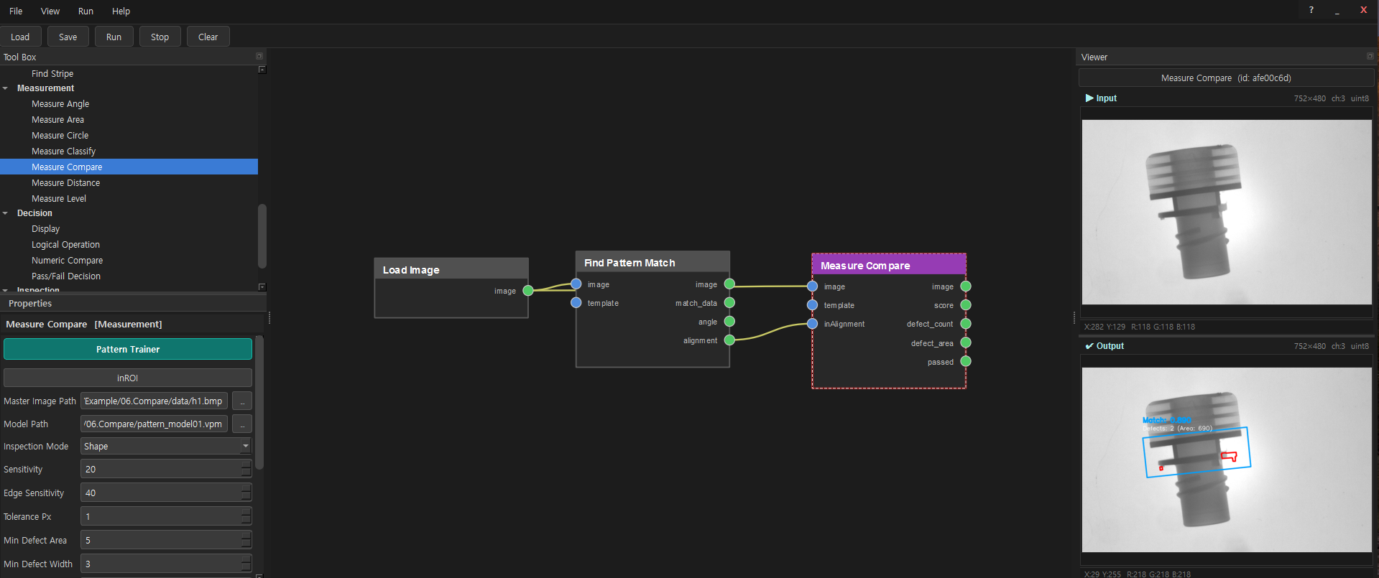
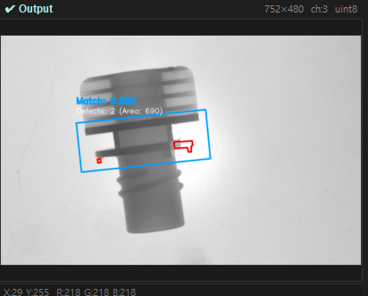
Measure Compare
노드 구조
Input image
- Measure Compare
Inspectrion Mode Shape / Noise Reduction 3

Slide 7
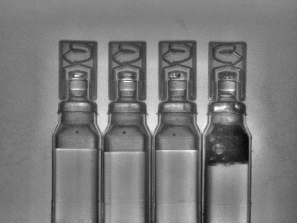
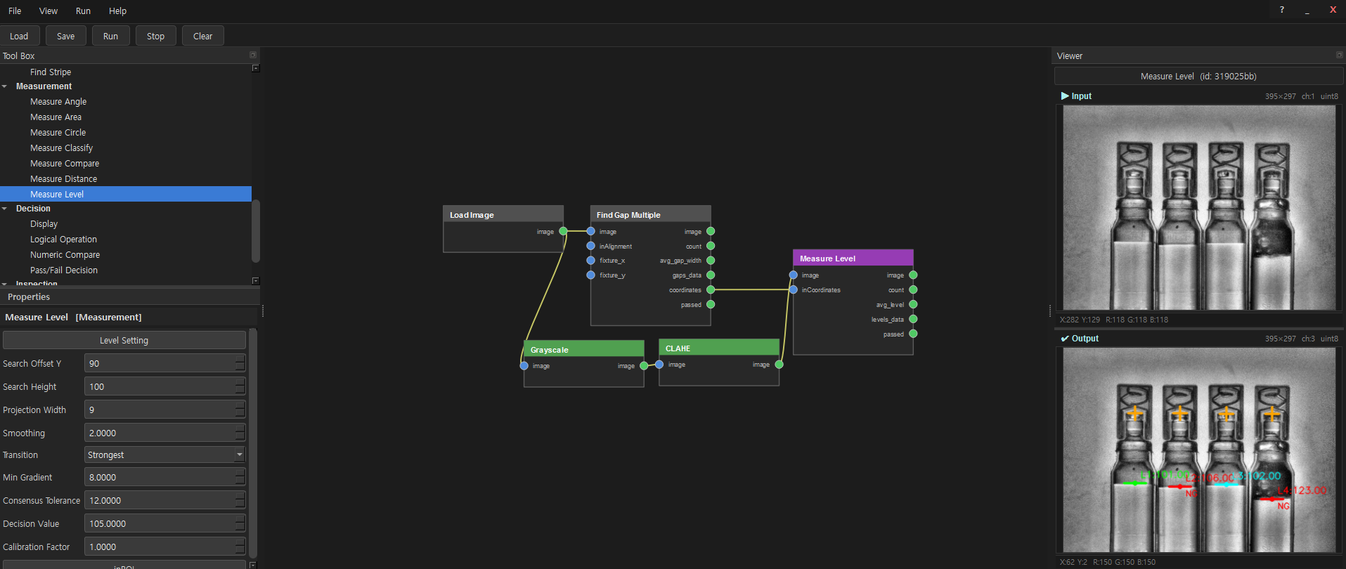
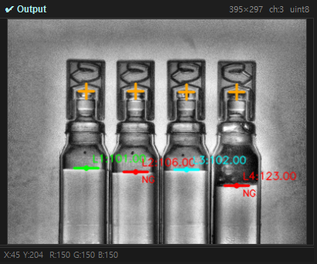
Measure Level
노드 구조
Input image
- Measure Level
Search Offset Y 90 / Search Height 100 / Decision Value 105.0000

Slide 9
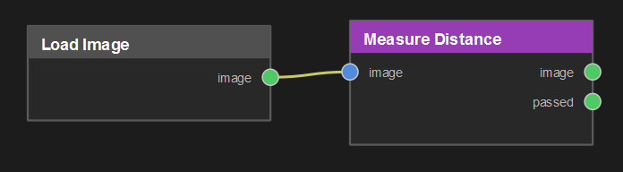

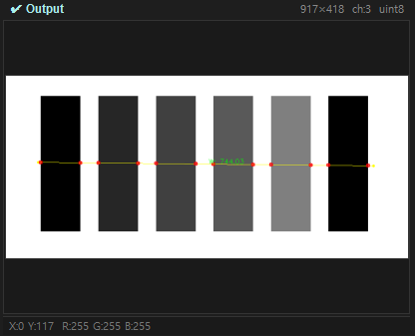
Measure Distance
노드 구조
Input image

Slide 10
